Slide 1
Naïve CD4 T stimulation RNA-seq, ATAC-seq and Hi-C

Slide 2
RNA-seq

Slide 3
First batch RNA-seq (non-stranded)
Low gene_feature % (DNA contamination)
Less than 10M reads usable

Slide 4
Second batch RNA-seq (stranded)
Low gene_feature % (DNA contamination)
Less than 10M reads usable

Slide 5
Third batch of naïve CD4 T RNA-seq technical QC
Improved gene_feature % (reduced DNA contamination)
Has enough reads (> 10M per sample) for next step

Slide 6
naïve CD4 T RNA-seq biological QC
ND589 stimulation (8hr and 24hr) is different from the other two donors
Can be fixed by introducing individual as covariant for differential analysis

Slide 7
Differential analysis of naïve CD4 T RNA-seq
34,026 genes with TPM >= 1
Differential analysis were performed on gene features with more than 10 reads on the top condition.
27404 gene features were used for differential analysis
Exp ~ individual. + condition (unstim, 8hr, 24hr)
Total 9,815 genes (9,525 genes with TPM >= 1) were differential expressed due to stimulation

Slide 8
Hierarchical cluster of DEG

Slide 9
ATAC-seq

Slide 10
Encode QC
Enough qc’ed reads

Slide 11
Encode QC – insertion histogram
ND517 ND578 TMP442
unstim
Besides mononucleosome, binucleosome, we can see tri-, quantra- nucleosome too.
Suspicious:
Under digestion
Insertion selection size too big
Very few reads will map to peak read (FiR
8hr
24hr

Slide 12
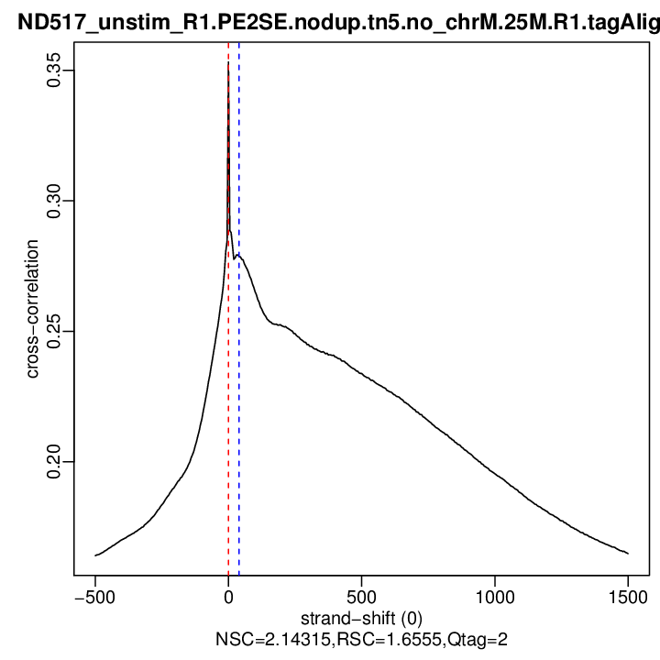
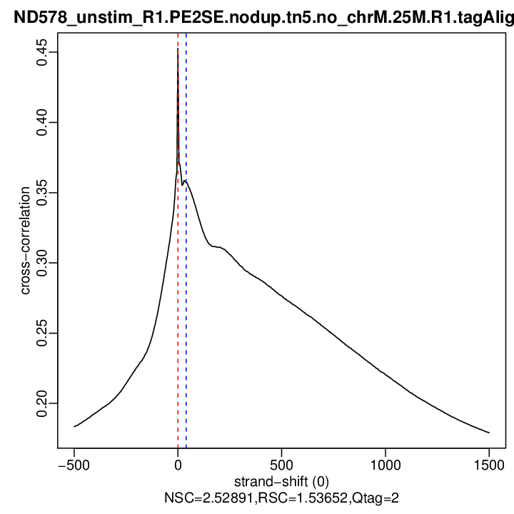
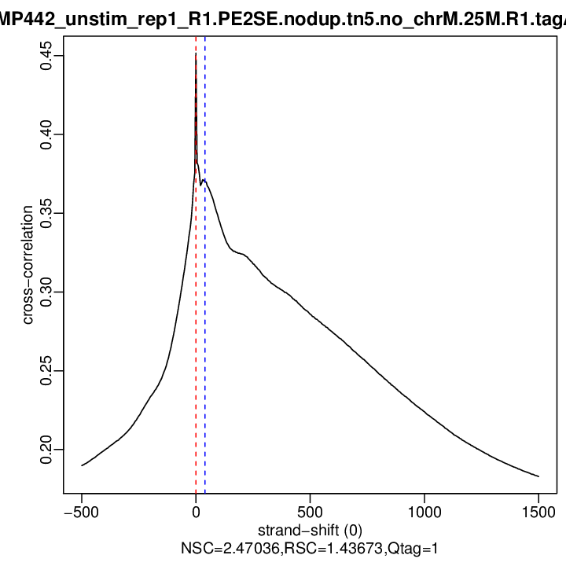
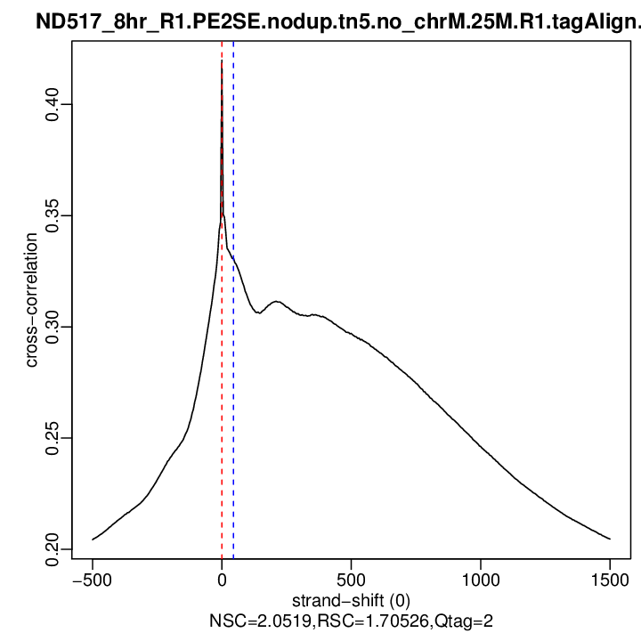
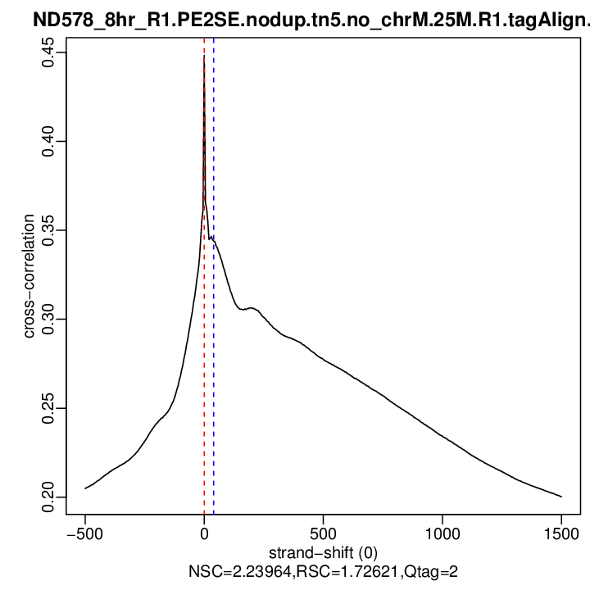
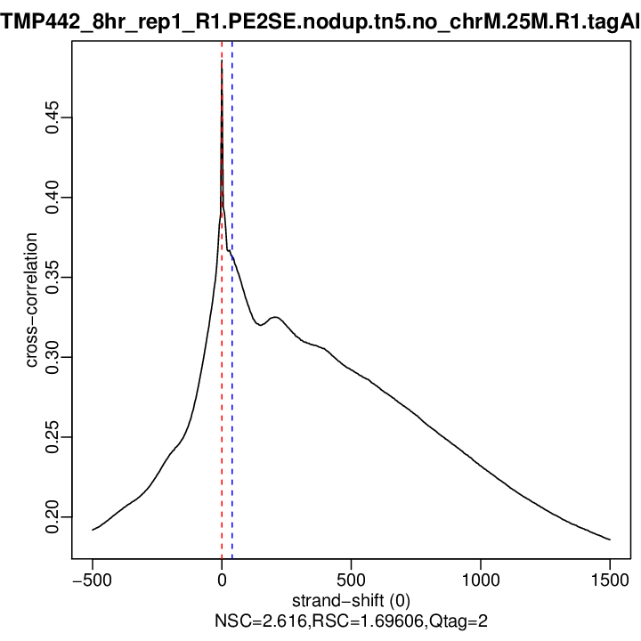
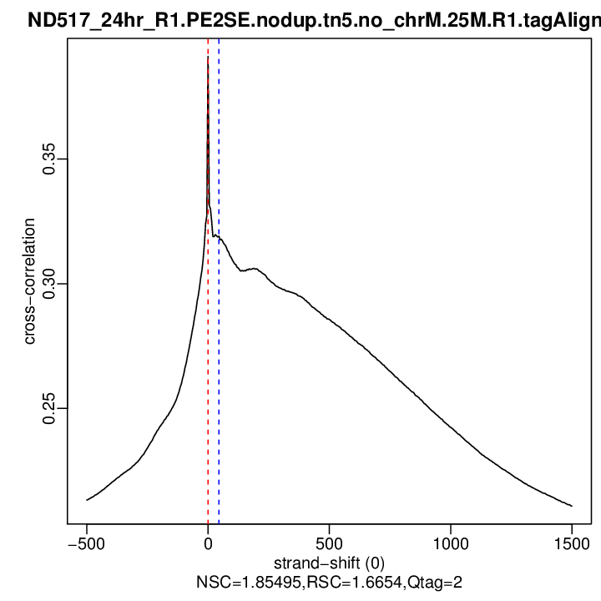
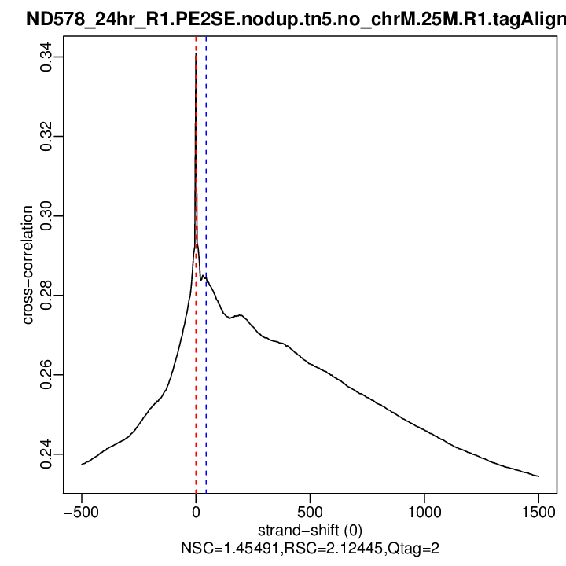
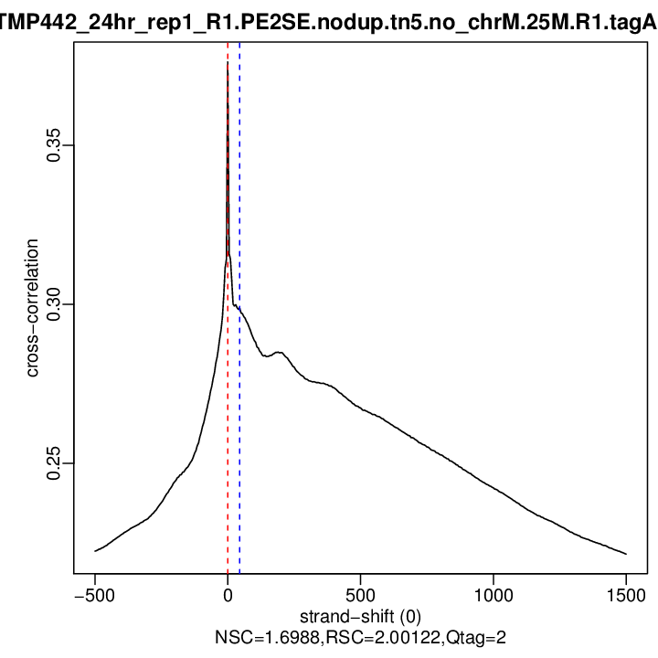
Encode QC – XCOR
ND517 ND578 TMP442
unstim
8hr
24hr

Slide 13
Peak calls
Using pooled reps to call peaks (poolRep peaks)
Filtering poolRep peaks with individual reps ( >= 2 reps)
Merge poolRep peaks to consensus peaks
http://genome.ucsc.edu/s/Chun.S/naiveT_PBMC

Slide 14
Annotate peak to gene promoter
32,637 (18%) peaks were annotated to promoter regions (-1500 ~ +500bp of TSS) of 24,560 genes.

Slide 15
ATAC-seq biological QC
Apply CPM >= 1 to keep top condition minimum read count per OCR is bigger than 5 reads.
76,539 out of 181093 retained for differential analysis
Cell stimulation correspond to PC1 and cluster

Slide 16
Differential Analysis of OCR
Accessibility ~ individual + condition
35,926 OCRs were differential among all pairwise
8062 DAR lies on the promoter of 7442 non-pseudo genes

Slide 17
Hi-C

Slide 18
Hi-C hicup preprocess
On average, 4 billion input -> 2 billion Hi-C qc-ed reads

Slide 19
Hi-C reproducibility
SCC: stratum-adjusted correlation coefficient
Cluster by condition at both 10Kb and 40kb resolution.

Slide 20
Hi-C loop call and annotation
2 callers at 3 resolutions – 1K, 2K, 4K
Fithic with FDR < 1e-6
Mustache pt < 0.1
Annotate loops to gene and OCR (consensus peaks)
Notes:
Call loops at 3 resolutions (1000, 2000, 4000) on merged replicates
2 different caller (mustache, fithic) + 2 different pvalue adjustment (FDR, hicACT) + 2 pvalue cutoff
Annotate loops to gene and OCR (consensus peaks)

Slide 21
Merge cross resolution and summarize annotation
In total, 27,544 genes and 79,930 OCRs were annotated to be connected in at least one condition by at least one methods across all resolutions

Slide 22
Hi-C loop differential analysis
Normalize interaction frequency across all samples.
Perform chromosome by chromosome (fastlo)
Globally evaluate interaction frequency to detect differentially interactive regions
differentially interactive regions: FDR < 0.05
Overlap with consensus loop
Consensus loop : merge loops across two calls (mustache pt < 0.1 and fithic FDR < 1e-6) and 3 conditions for each resolution

Slide 23
Differential interaction loop summary
Notes:
Rdata

Slide 24
Virtual DpnII bait capture
On average, ~ 50M captured reads, 65% cis ratio.

